Slide 1
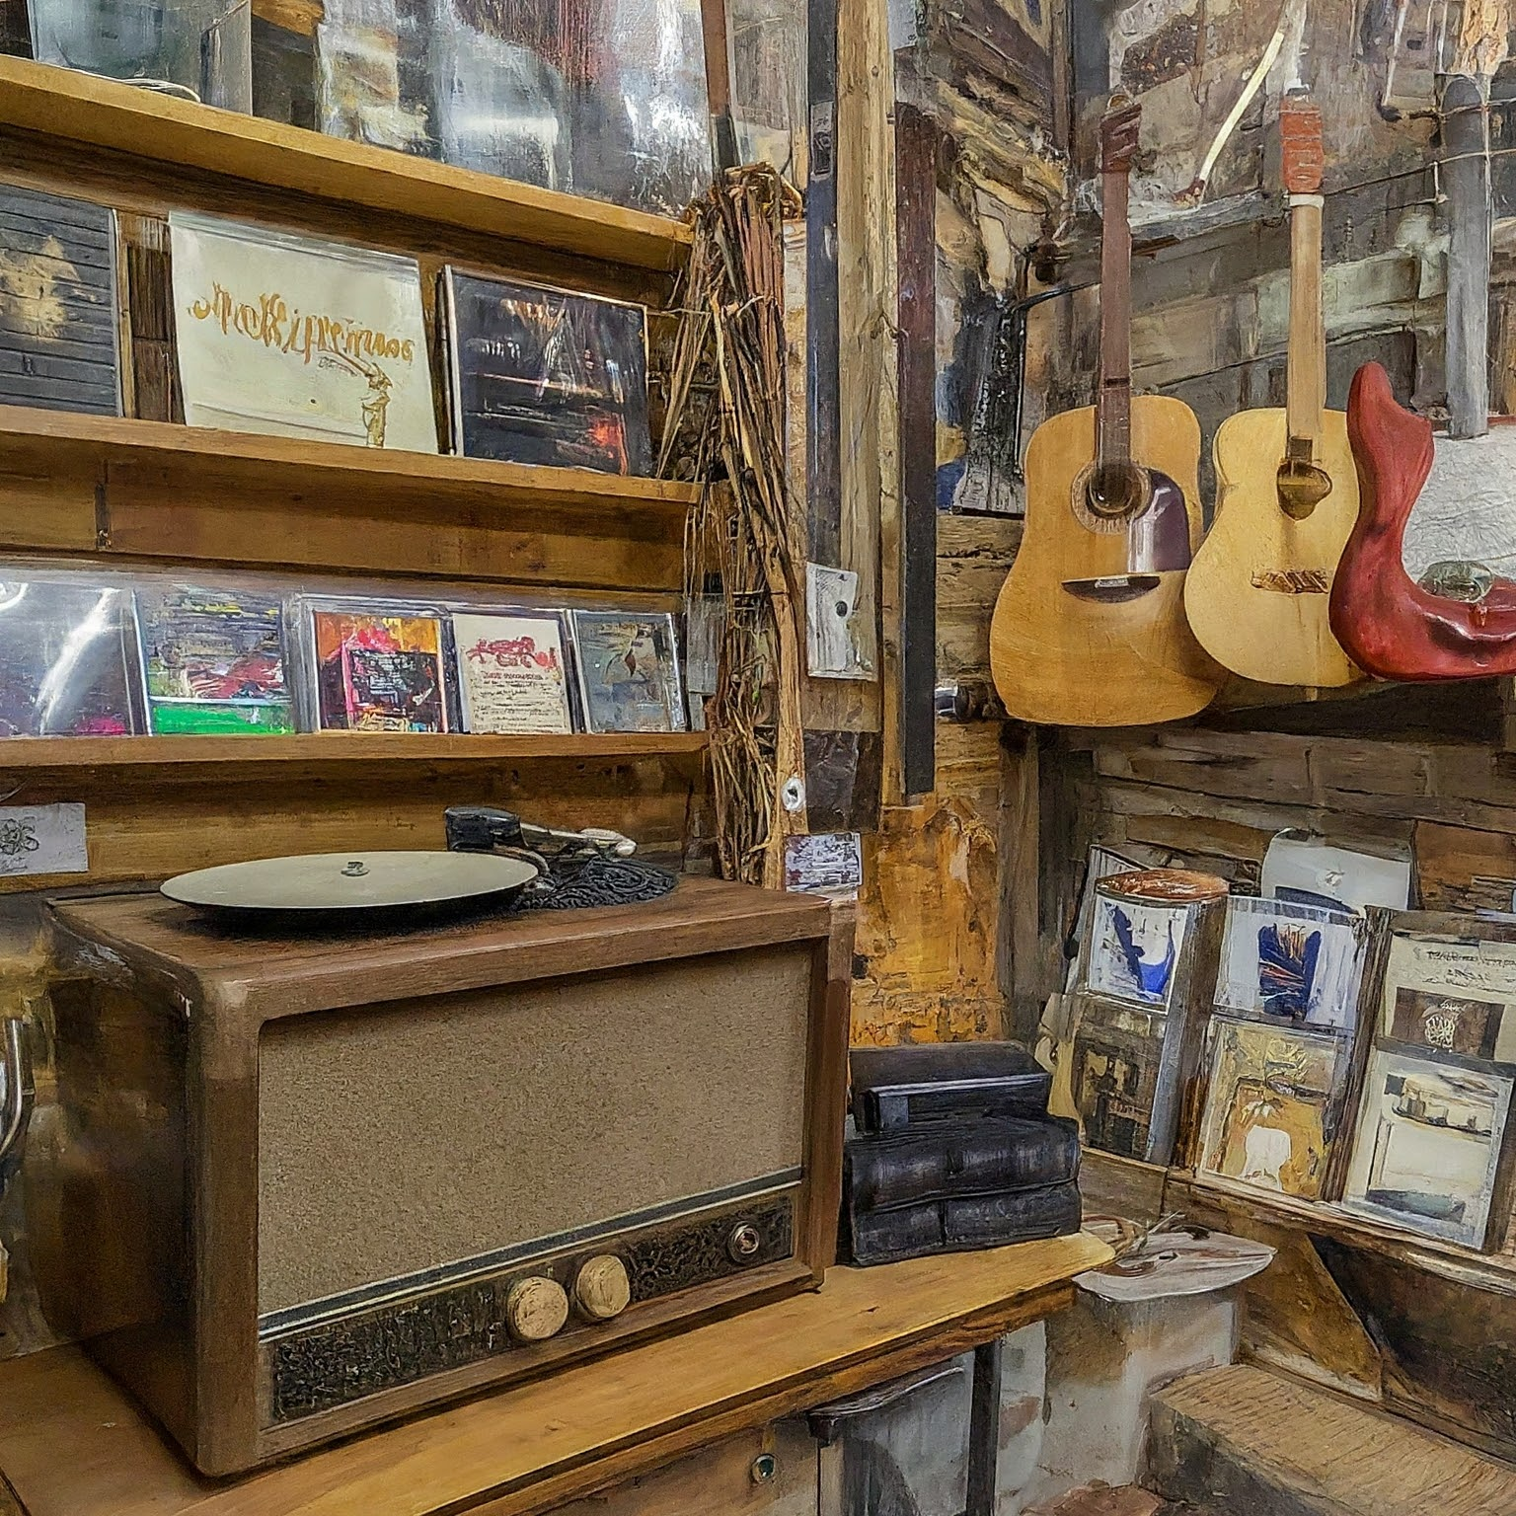
EXPLORING THE CHINOOK MUSIC STORE DATABASE
By Drohan Thipe

Slide 2
PROBLEM STATEMENT
Identify and address missing values and duplicates to ensure data integrity.
Determine top-selling tracks, artists, and genres, both in the USA and globally.
Analyze customer demographics and purchasing behavior, including churn rate and frequency.
Calculate total revenue and top customers by region, with a focus on geographical differences.
Recommend albums for promotion based on genre sales performance and customer preferences.
Segment customers based on purchase history to predict lifetime value and identify high-risk groups.

Slide 3
AGENDA
INTRODUCTION
DATABASE SCHEMA
INSIGHTS
CONCLUSION

Slide 4




1. INTRODUCTION
The main objective of this project is to explore and analyse the chinook database using SQL to uncover valuable business insights.
This involves querying the database to gain a deeper understanding of customer behaviour, sales, trend, and the management of the music library
In the modern business environment, data analysis plays a vital role decision-making.
By leveraging SQL, businesses can extract meaningful patterns and trends from their data, enabling them to make informed decisions, optimize strategies, and improve overall performance.

Slide 5
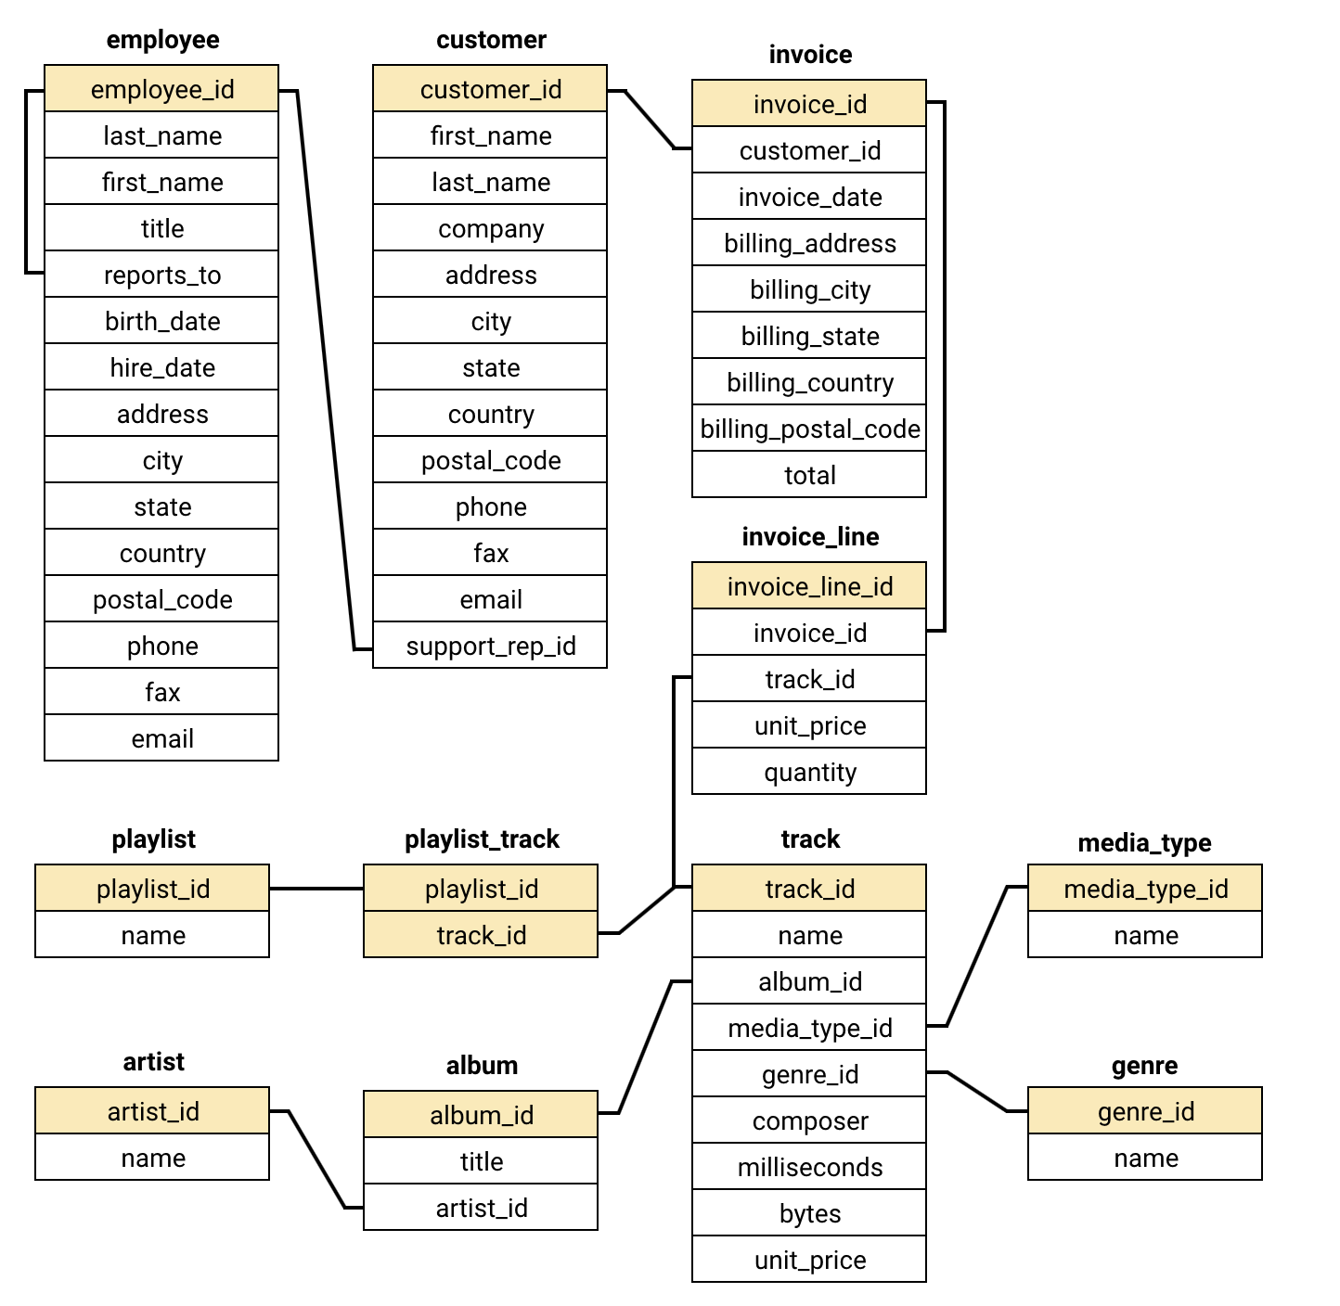
2. DATABASE SCHEMA

Slide 6
3. INSIGHTS
3.1 TOTAL REVENUE AND NUMBER OF INVOICES FOR EACH COUNTRY, STATE, AND CITY?
3.2 TOP 5 CUSTOMERS BY TOTAL REVENUE IN EACH COUNTRY
3.3 CUSTOMERS WHO HAVE PURCHASED TRACKS FROM AT LEAST 3 DIFFERENT GENRES
3.4 AVERAGE ORDER VALUE FOR EACH CUSTOMER
3.5 TOTAL REVENUE GENERATED BY EACH CUSTOMER
3.6 THREE ALBUMS -- PRIORITIZED FOR ADVERTISING AND PROMOTION IN THE USA BASED ON GENRE SALES ANALYSIS
3.7 GENRES, ARTISTS, OR ALBUMS FREQUENTLY PURCHASED TOGETHER BY CUSTOMERS
3.8 CUSTOMER PURCHASING BEHAVIORS BY REGION
3.9 NUMBER OF CUSTOMERS AND THE AVERAGE NUMBER OF TRACKS PURCHASED PER CUSTOMER

Slide 7
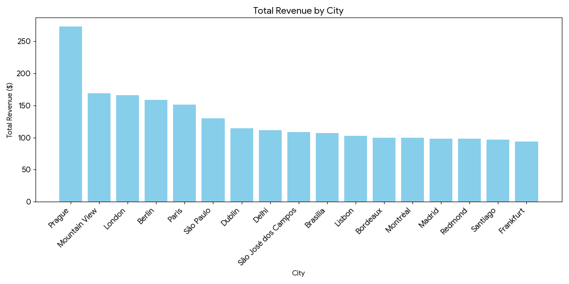
3.1 TOTAL REVENUE AND NUMBER OF INVOICES FOR EACH COUNTRY, STATE, AND CITY?
Broad Global Reach: Customers are spread across several countries, including Argentina, Australia, Brazil, Canada, and the USA.
Top Hubs: London (UK) and Mountain View (USA) lead with two customers each.
Secondary Concentrations: Higher activity is noted in major cities like Paris, Berlin, São Paulo, and Prague.
Strong Canadian Presence: Wide representation across Ontario, BC, Alberta, and Quebec.
Shallow Distribution: Most other cities currently have only a single customer.

Slide 8
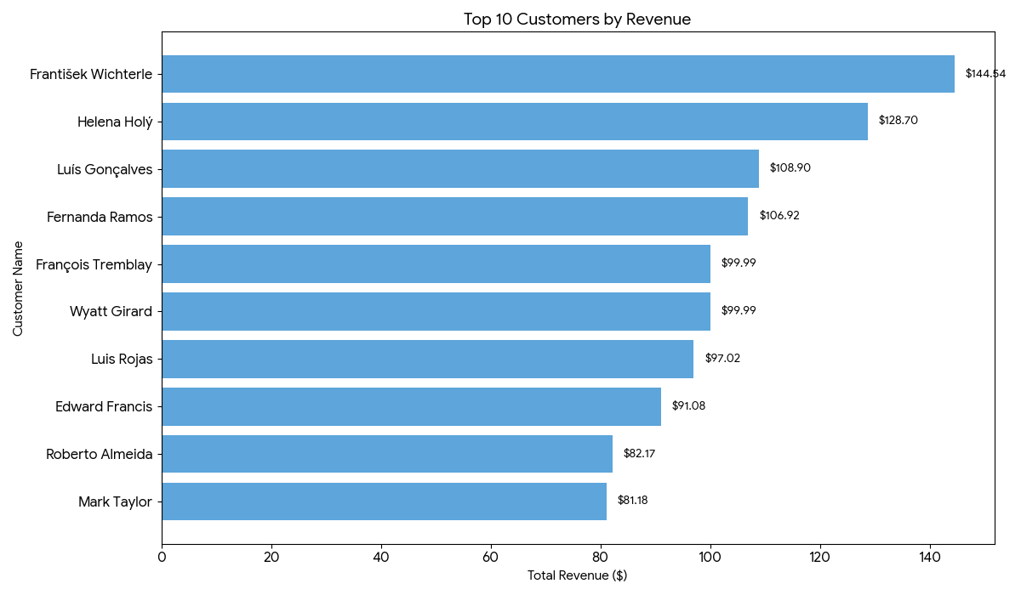
3.2 TOP 5 CUSTOMERS BY TOTAL REVENUE IN EACH COUNTRY
Top Earner: František Wichterlová (Czech Republic) leads with 144.54 in revenue.
Key Markets: Significant revenue contributions come from Brazil, the USA, Canada, and the Czech Republic.
Regional Strengths: Brazil holds a high concentration of top-ranked revenue earners.
US Lead: Jack Smith is the top US performer with 98.01 in revenue.
Market Consistency: High-value customers are distributed relatively evenly across multiple countries.

Slide 9
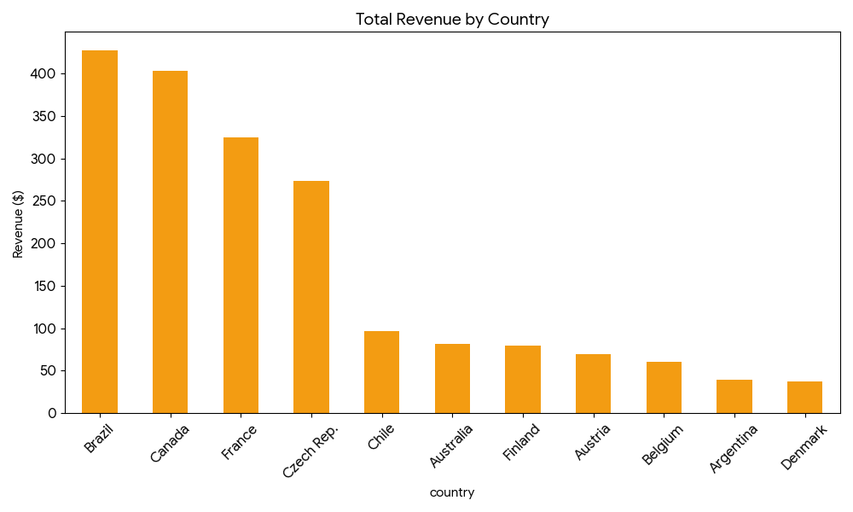
3.3 CUSTOMERS WHO HAVE PURCHASED TRACKS FROM AT LEAST 3 DIFFERENT GENRES
Diversity Leader: Leonie Köhler leads with purchases across 14 different genres.
High Engagement: Many customers (e.g., Wichterlová, Hämäläinen, Sampaio) follow closely with 13 genres.
The Majority: Most customers show broad taste, typically engaging with 10 to 12 genres.
Niche Listeners: A small group (e.g., Brown, Nielsen, Stevens) maintains a focused interest in only 5 to 6 genres.
General Trend: Data confirms a strong overall tendency toward musical exploration rather than narrow specialization.

Slide 10
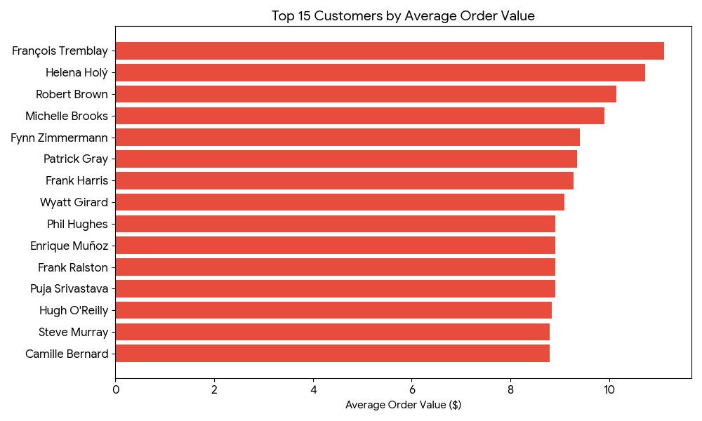
3.4 AVERAGE ORDER VALUE FOR EACH CUSTOMER
Top Average Spenders: François Tremblay leads at 11.11 per order, followed closely by Helena Holý and Robert Brown (both above 10).
Standard Spenders: The majority of customers maintain a moderate average between 7 and 9.
Low Average Spenders: Mark Phillips (2.97) and Kara Nielsen show the lowest averages, suggesting smaller, more frequent transactions.
Spending Diversity: The wide range of values highlights varied purchasing strategies across the customer base.

Slide 11
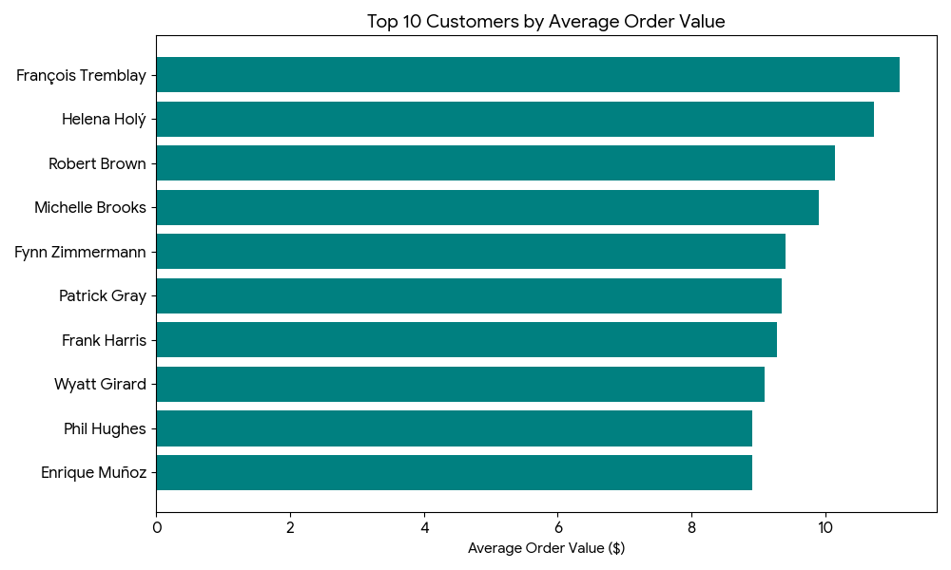
3.5 TOTAL REVENUE GENERATED BY EACH CUSTOMER
Top Performer: František Wichterlová leads all customers with 144.54 in total revenue.
Key Contributors: High-value customers like Helena Holý, Hugh O'Reilly, and Manoj Pareek each exceed 100 in revenue.
Solid Middle Tier: A large portion of the base provides steady revenue between 70 and 100.
Lower Tier: Customers like Kara Nielsen, Robert Brown, and Mark Phillips (lowest at 29.7) contribute the least.
Revenue Gap: There is a significant disparity between the top-tier earners and the bottom of the spectrum.

Slide 12
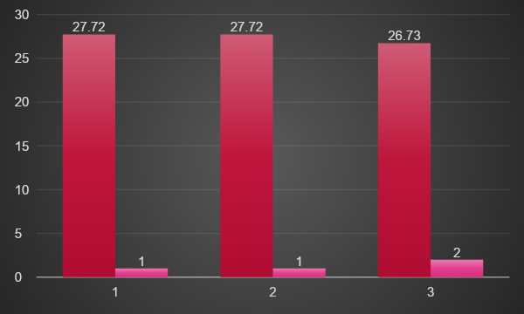
3.6 THREE ALBUMS -- PRIORITIZED FOR ADVERTISING AND PROMOTION IN THE USA BASED ON GENRE SALES ANALYSIS
Market Dominance: Rock is the leading genre in the USA, consistently producing the highest total sales figures.
Genre Concentration: The market shows a heavy preference for Rock music, with the top three best-selling albums all belonging to this genre.
Promotion Strategy: Due to their proven high sales volume, these top Rock albums are the primary candidates for increased marketing spend.
Actionable Priority: Advertising and promotional efforts should be focused on the USA to capitalize on the current high demand for Rock.

Slide 13
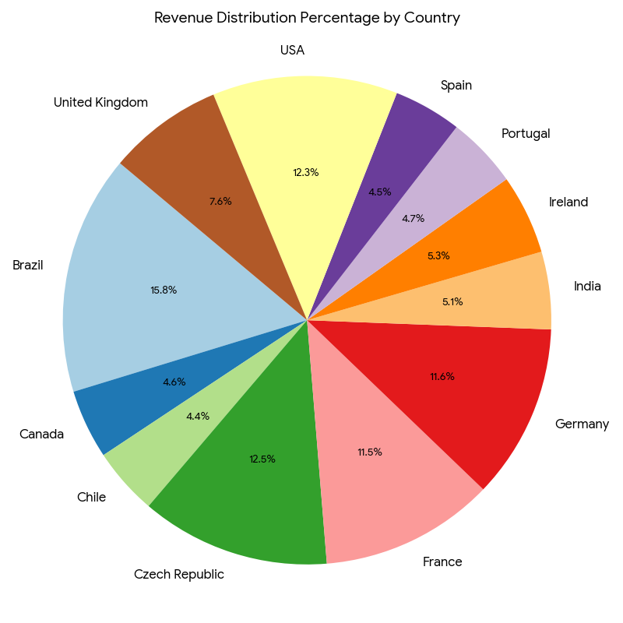
CONTINUING…
Broad Appeal: "Mezmerize" is frequently bundled with classic rock staples like "Are You Experienced?" and "The Police Greatest Hits."
Cross-Genre Interest: Strong co-purchase patterns exist between "The Police Greatest Hits" and "My Generation," as well as "Big Ones" and "Back to Black."
Market Synergy: These buying patterns reveal that customers often bridge different rock sub-genres and eras in a single transaction.

Slide 14
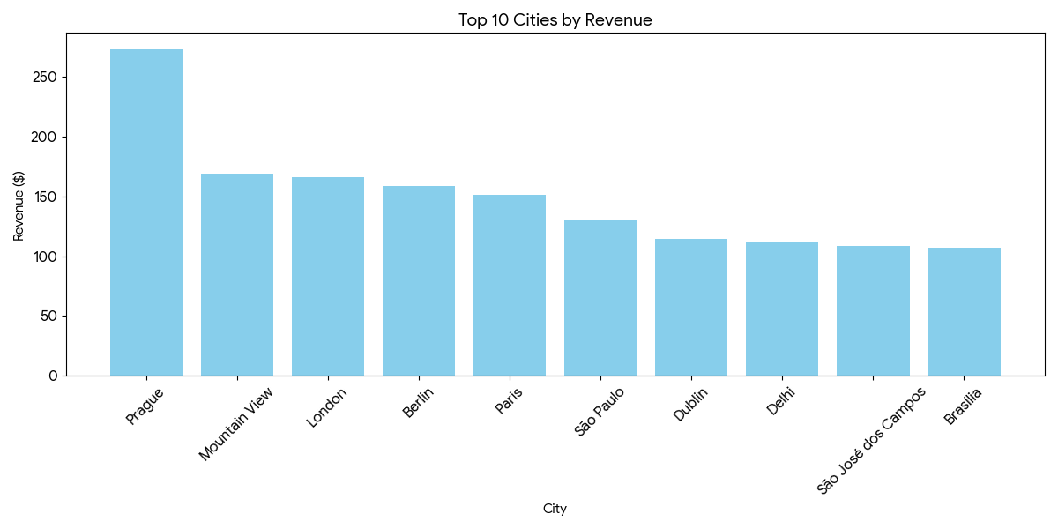
3.8 CUSTOMER PURCHASING BEHAVIORS BY REGION
Premium Targets: High order value and frequency in Prague, Mountain View, and London make these cities ideal for high-end products.
Retention Focus: Moderate performance in São Paulo and Berlin suggests a strategy centered on loyalty and repeat purchases.
Growth Opportunities: Low sales in Edmonton and Copenhagen indicate a need for targeted promotions to stimulate volume.

Slide 15
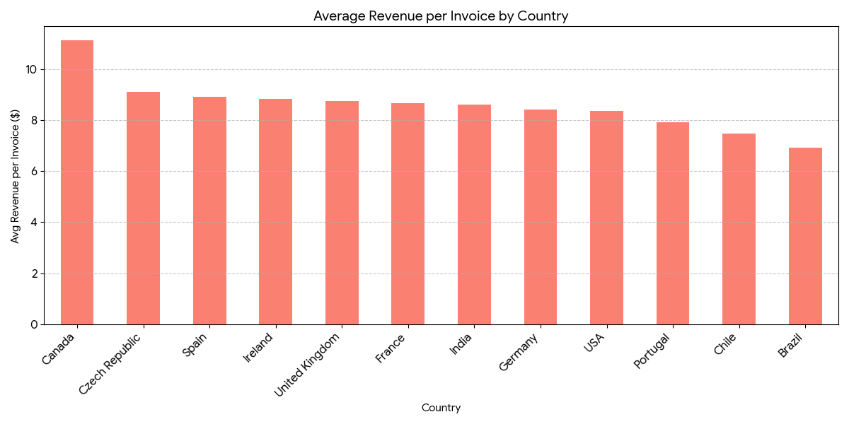
3.9 NUMBER OF CUSTOMERS AND THE AVERAGE NUMBER OF TRACKS PURCHASED PER CUSTOMER
Top Value Market: The Czech Republic leads with the highest average spend at $136.62 per customer.
Volume vs. Value: While the USA has the largest customer base, it shows lower engagement with an average spend of $80.04.
Moderate Performers: India, Portugal, and Brazil maintain mid-range spending levels.
Low Engagement: Argentina and Denmark show the lowest customer value, with averages hovering around $40.

Slide 16
4. CONCLUSION
Data Integrity: Cleaned the Chinook database by resolving nulls and duplicates to ensure reporting accuracy.
Genre Leadership: Rock dominates globally, specifically in the USA; however, Brazil shows distinct preferences for Alternative & Punk and Metal.
Customer Loyalty: Long-term users exhibit higher lifetime value; new users represent growth opportunities via personalization.
Sales Strategy: Use identified genre and artist affinities to drive effective cross-selling and product bundling.
Retention & Risk: High-value customers require bespoke engagement; predictive modeling is recommended to mitigate churn.
Core Recommendation: Prioritize top genres, launch loyalty programs, and leverage data-driven insights for marketing.

Slide 17
THANK YOU

